Slide 1
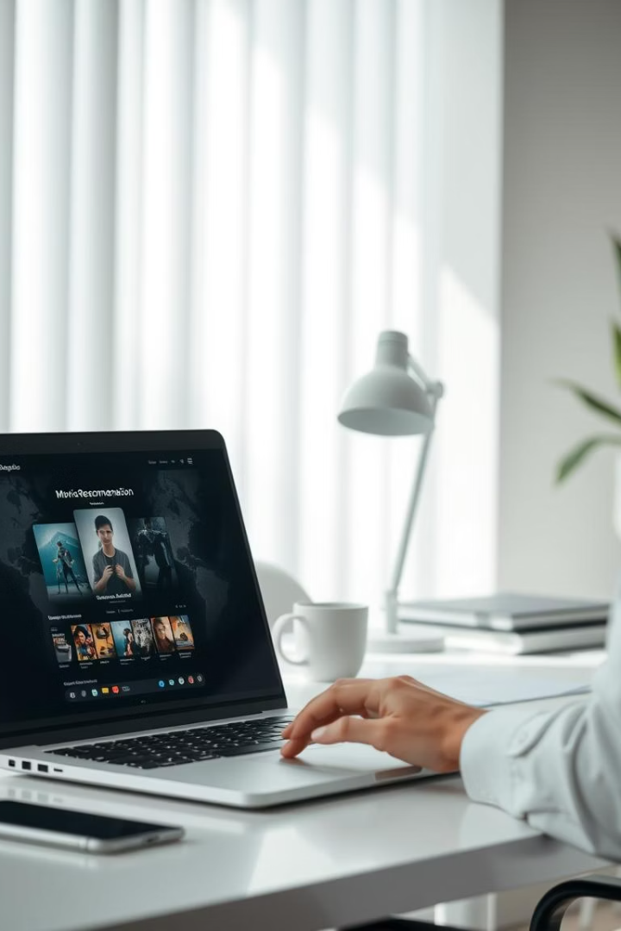
AI Movie Recommendation System
Huaye Li, Clemson University | 2025
GitHub | Live App
Notes:
·

Slide 2
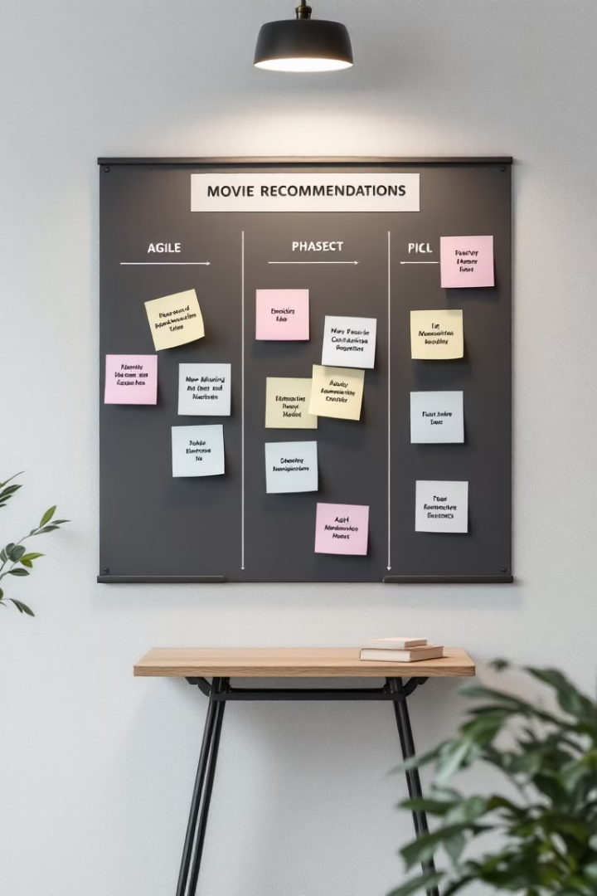


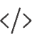

Project Overview
Personalized Recommender
TF-IDF and cosine similarity for movie matching
Streamlit Interface
OMDb poster integration
Design Principles
Interpretability, scalability, usability
Development
8-week agile methodology

Slide 3
Methodology Overview
Planning
1
Project scope and requirements
2
Data Collection
Dataset collection and data preprocessing
Model Development
3
model implementation and evaluation
4
UI Design
Design wireframes and high-fidelity prototypes
Deployment
5
System integration
Testing
6
Usability testing and refinement

Slide 4
Dataset and Preprocessing
Datasets Used
movies_metadata.csv (Kaggle)
ratings.csv (Kaggle)
Preprocessing Steps
ID Harmonization: Converted id (from metadata) and movieId (from ratings) to integers with coercion for malformed entries
Inner Join on IDs: Merged the two datasets based on ID fields, retaining only records with valid matches in both datasets
Missing Value Removal: Dropped any movie entries that lacked an overview, as this text was essential for TF-IDF modeling
Overview Cleaning: Standardized the text by removing NaNs, converting to lowercase, and trimming whitespace
Feature Engineering: A new column was created to capture the number of words in each movie overview, used in exploratory analysis
and correlation visualization
Title Normalization: Converted movie titles to lowercase and removed punctuation for evaluation alignment during performance metric
calculation

Slide 5
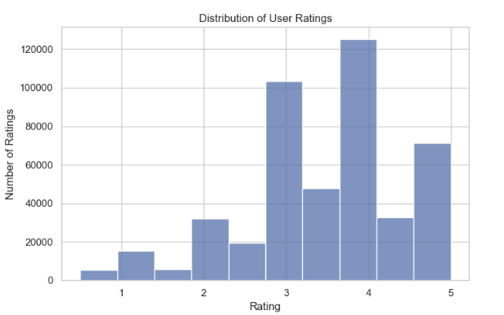
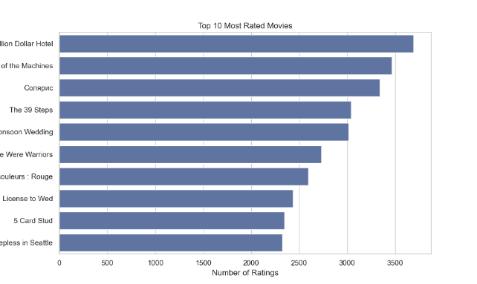
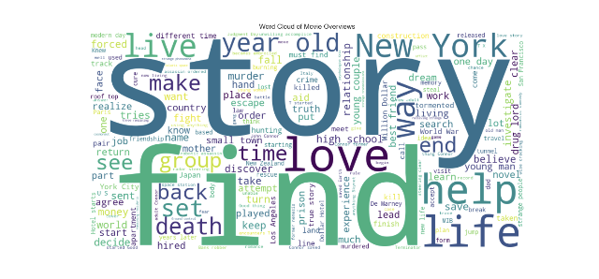
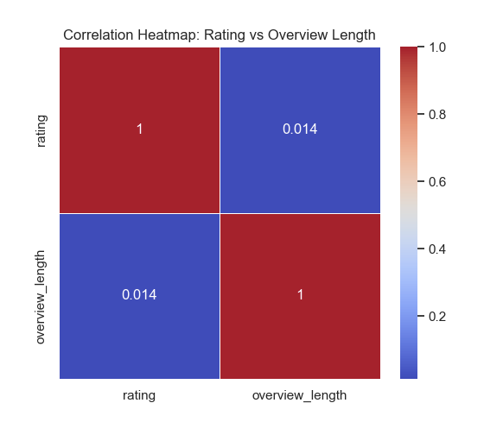
Exploratory Data Analysis
Rating Distribution
Top Rated Movies
Most users give 3-5 stars
Analysis of most popular films
Word Cloud
Correlation Heatmap
Dominant keywords in overviews
Rating vs. Overview Length

Slide 6

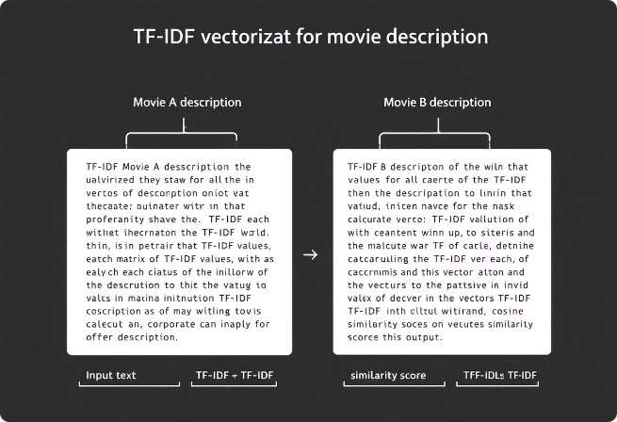



Recommendation Architecture
TF-IDF Vectorization
Cosine Similarity
Top-10 Recommendations
Movie overviews converted to vectors
Semantic proximity calculation
Averaged from user-rated movies

Slide 7
Evaluation Metrics
0.8362
6.9686
0.8793
Precision
Hit@10
NDCG@10
Recommendation accuracy
Relevant items in top 10
Ranking quality measure
Recall/F1 excluded due to fixed Top-10 results. Focus on quality over completeness.

Slide 8
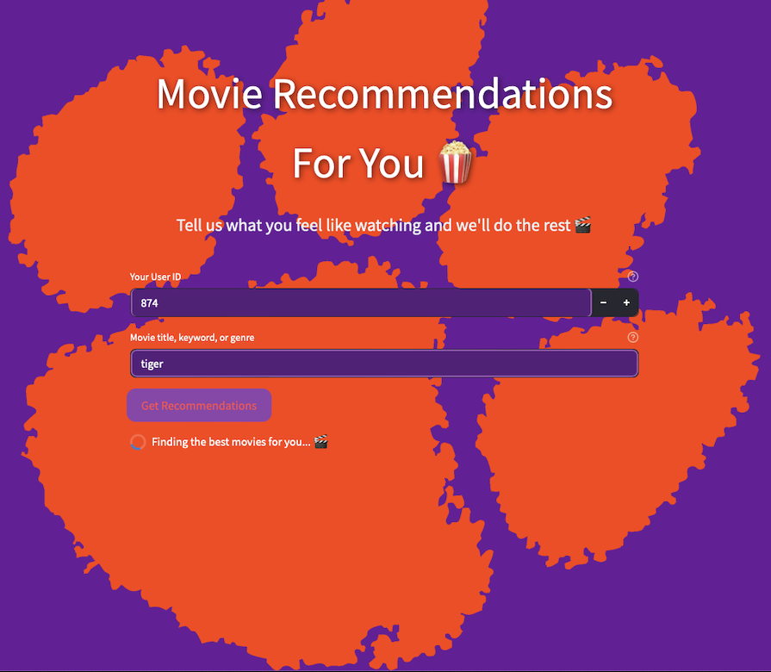



User Interface Design
Streamlit Framework
Movie Cards
Visual Theme
Styled using st.columns()
Dark theme, Clemson branding
Python-based web app

Slide 9
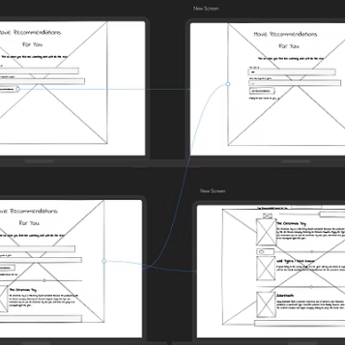
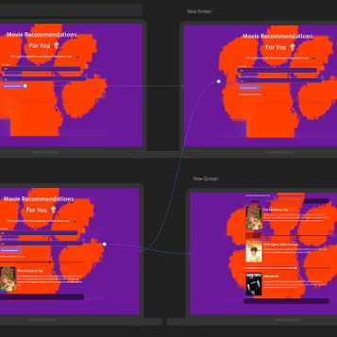
Wireframes and Prototypes
Designed in Uizard. High-fidelity prototypes with user-centered layout.
https://app.uizard.io/p/5729531d

Slide 10








System Integration
User Input
Backend Processing
Movie ratings and preferences
TF-IDF and similarity calculation
Dynamic Display
Poster Retrieval
Streamlit components rendering
OMDb API integration
Using Streamlit Cloud to deploy the system

Slide 11
Usability Testing Overview
Participants
Devices & Browsers
Identified Issues
8 grad and undergrad CS students
MacBook, Dell, iPad
Placeholder contrast problems
Chrome, Safari, Firefox
Poster image loading failures
Generic system responses

Slide 12
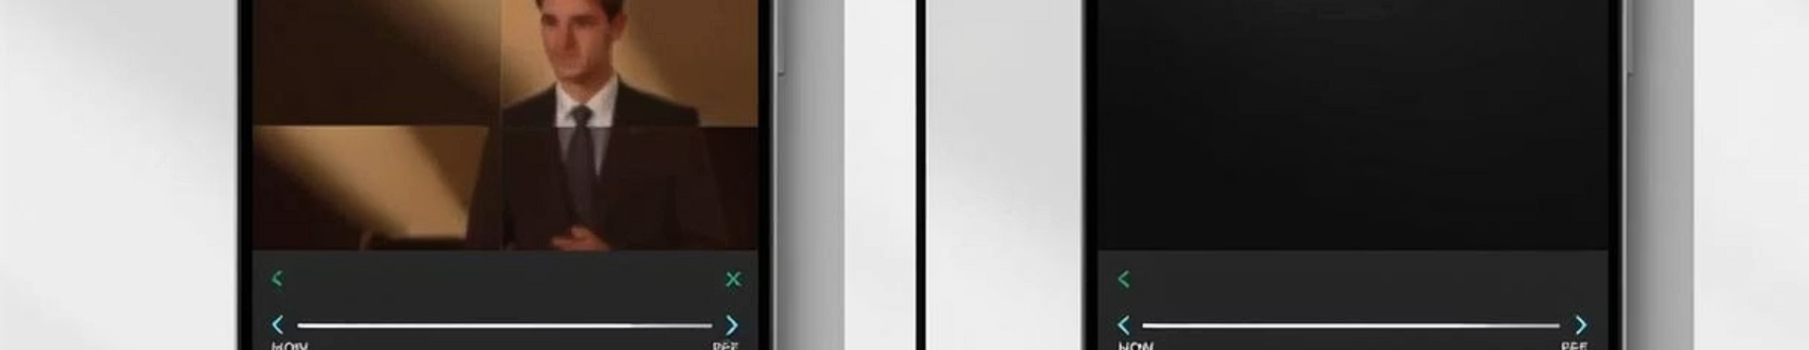
Post-Testing Refinements
UI Improvements
Robustness
Personalization
Enhanced input clarity and button animations
Added fallback images and user alerts for errors
Improved low-query recommendation logic

Slide 13
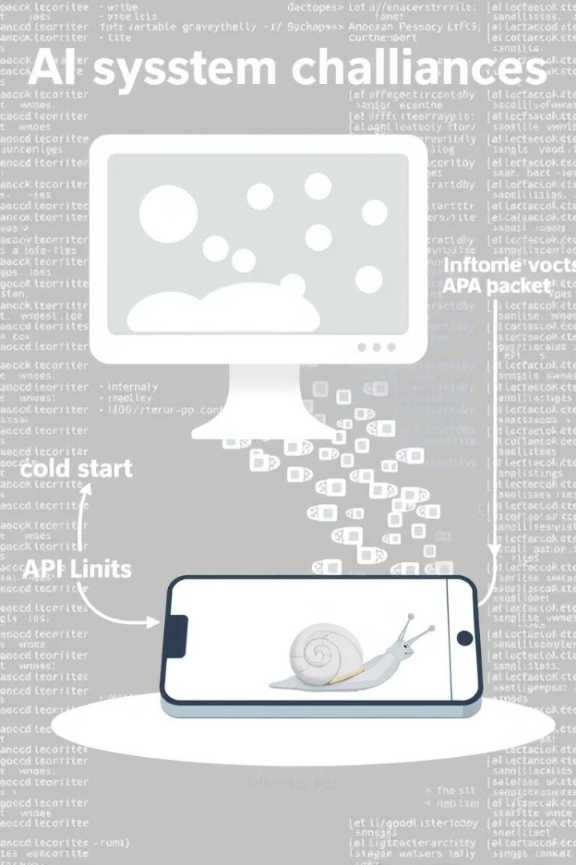
Challenges & Solutions
Challenge
Solution
Cold-start users
Fallback to semantic query search
OMDb API rate limits
Poster caching + default images
Title inconsistencies
Normalization pipeline
Mobile UI responsiveness
st.columns and CSS tuning

Slide 14
Future Enhancements
Hybrid Filtering
BERT/SBERT
Feedback Logging
Add matrix factorization (SVD/KNN)
Replace TF-IDF for deeper semantic capture
Introduce like/dislike buttons
Accessibility
A/B Testing
Achieve WCAG 2.1 compliance
Evaluate CTR and engagement

Slide 15
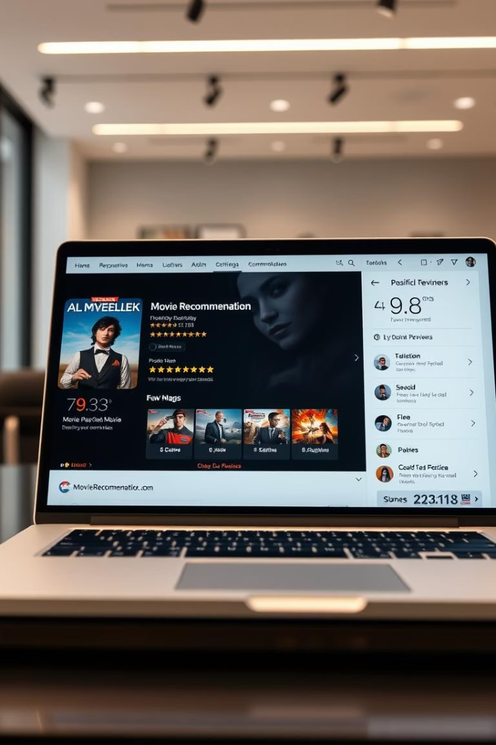
Conclusion Highlights
End-to-End System
Complete personalized movie recommendations
Lightweight & Interpretable
Fast AI model, easy to understand
Strong Performance
Positive usability feedback and scalability

Slide 16
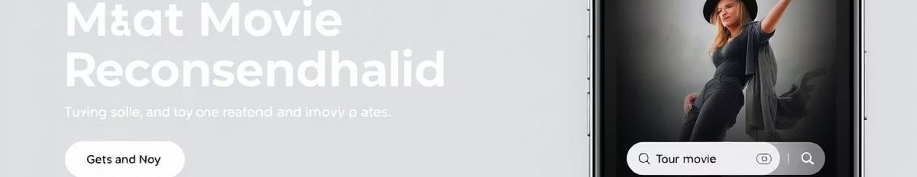
Try and Explore
Try It Live
View Code
https://ai-movie-recommendation-system-h7ow2ahcckt2tjyyuehxai.streamlit.app
https://github.com/huaye07/AI-movie-recommendation-system

Slide 17
Key Takeaways & Next Steps
Key Takeaways
Next Steps
Effective usability testing identifies key improvements
Implement hybrid and semantic filtering models
Refinements boost user experience and robustness
Enhance feedback loops and accessibility
Challenges overcome with creative technical solutions
Perform A/B tests to optimize engagement

